Slide 1
A set of Wireless and Wired Power Transfer Systems
Studies
Enes Ayaz
^{10/01/2023}

Slide 3
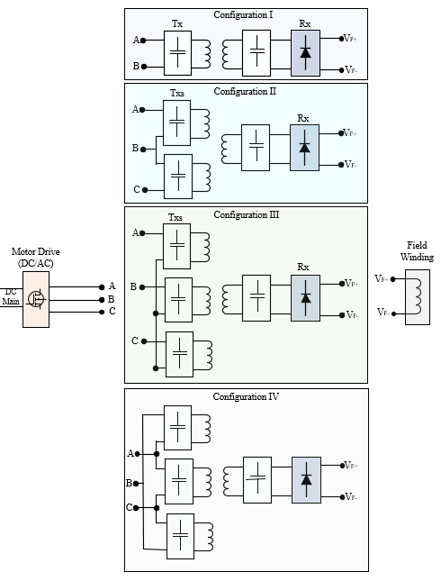
Previously on the 30-min Presentation
Motor drives have more than 2 wires
Conventional WPT systems have 2 wires input
Multi-phase WPT systems
Motivations:
To increase DC-link utilization rate
To increase power
To break the restrictions
Notes:
The WPT system is connected between phase-A and phase B.
By carrier phase shift to phase B, we achieve this contour of the magnitude of the switching frequency.
We can observe that we can have a constant gain for any modulation.
The constant gain is between 0.25 and 0.45 over a DC-link voltage.
The control diagram is shown.
We adjust the carrier phase shift according to modulation to control the WPT power.

Slide 4
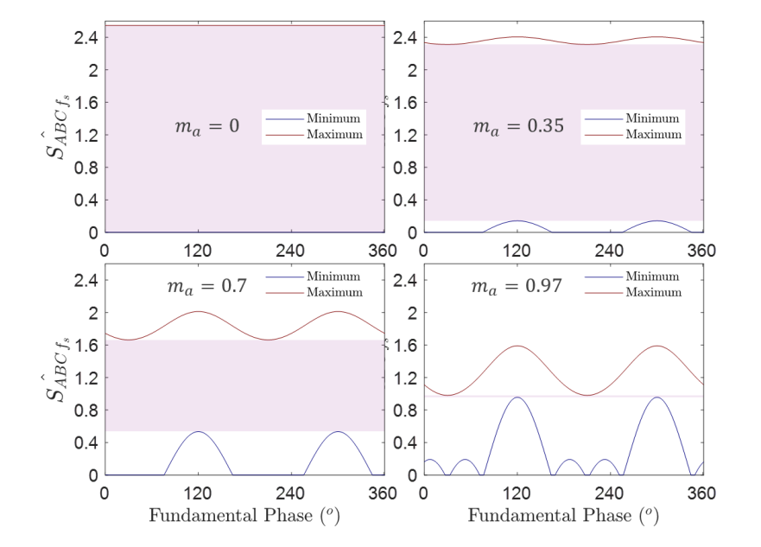
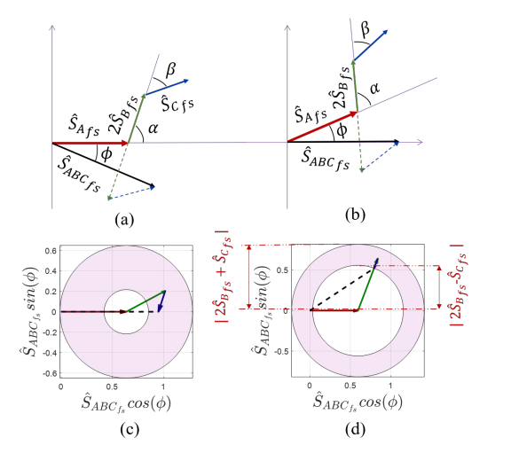
Future Works
Notes:
The WPT system is connected between phase-A and phase B.
By carrier phase shift to phase B, we achieve this contour of the magnitude of the switching frequency.
We can observe that we can have a constant gain for any modulation.
The constant gain is between 0.25 and 0.45 over a DC-link voltage.
The control diagram is shown.
We adjust the carrier phase shift according to modulation to control the WPT power.

Slide 5
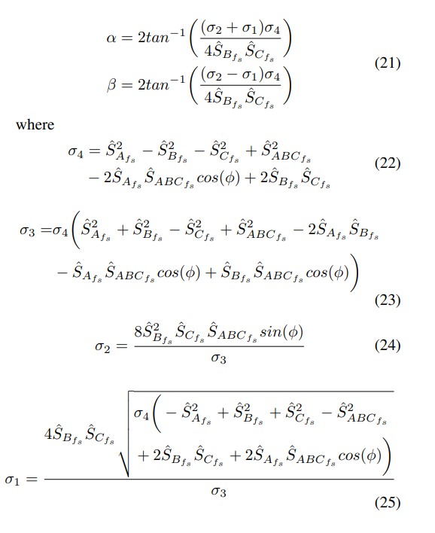
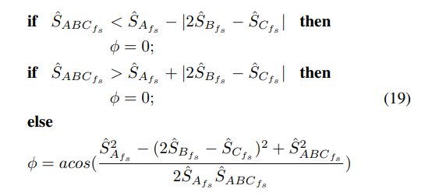
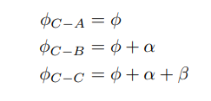
Challenge- Calculation Burden!
Notes:
The WPT system is connected between phase-A and phase B.
By carrier phase shift to phase B, we achieve this contour of the magnitude of the switching frequency.
We can observe that we can have a constant gain for any modulation.
The constant gain is between 0.25 and 0.45 over a DC-link voltage.
The control diagram is shown.
We adjust the carrier phase shift according to modulation to control the WPT power.

Slide 6
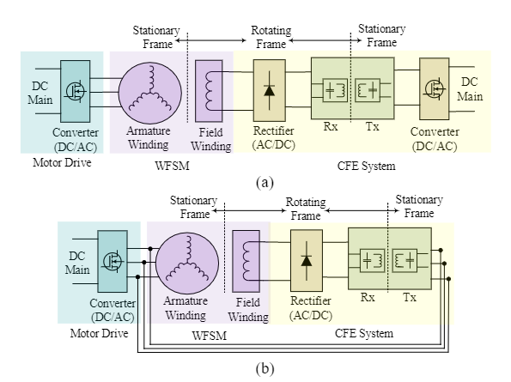
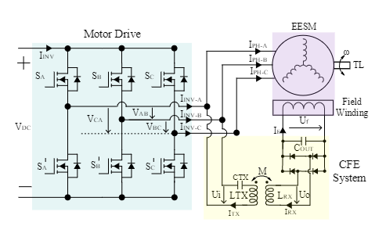
Variable Carrier Phase Shift Method for Integrated Contactless Field Excitation System of Electrically Excited Synchronous Motors
The circuit diagram of a conventional and proposed CFE based on a WPT system for EESMs.
a) The conventional system. b) The proposed system.
The circuit diagram of the proposed system
Notes:
The WPT system is connected between phase-A and phase B.
By carrier phase shift to phase B, we achieve this contour of the magnitude of the switching frequency.
We can observe that we can have a constant gain for any modulation.
The constant gain is between 0.25 and 0.45 over a DC-link voltage.
The control diagram is shown.
We adjust the carrier phase shift according to modulation to control the WPT power.

Slide 7
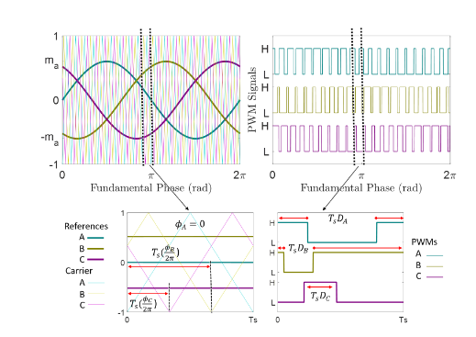
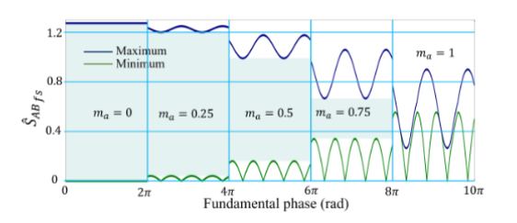
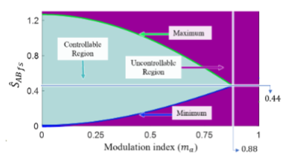
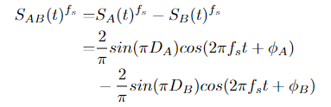
Variable Carrier Phase Shift- Time Domain Analysis

Slide 8
Multifrequency IPT Systems
Standards:
Wireless Power Consortium (WPC)
Power Matters Alliance (PMA)
Alliance for Wireless Power (A4WP)
Motivations:
To Increase power
To reduce switching components
To increase DC-link utilization rate
To provide operation for more than one standards
Some Topologies:
Multi-converter and multi-resonant
Single-converter and multi-resonant
Single-converter and multi-load
100 - 205/300 kHz for magnetic resonant and induction technology for mobile devices; WPT systems for consumer devices, power transfer typically < 200 W; plan to be used worldwide
6765 - 6795 kHz for magnetic resonant technology for mobile devices; WPT systems for consumer devices, power transfer typically < 30 W; plan to be used.
300 - 500 kHz: WPT systems for consumer devices, power transfer typically < 5 W; plan to be used for smaller devices.
900 - 1 000 kHz: WPT systems for consumer devices, power transfer typically < 5 W; plan to be used for smaller devices.
Notes:
The WPT system is connected between phase-A and phase B.
By carrier phase shift to phase B, we achieve this contour of the magnitude of the switching frequency.
We can observe that we can have a constant gain for any modulation.
The constant gain is between 0.25 and 0.45 over a DC-link voltage.
The control diagram is shown.
We adjust the carrier phase shift according to modulation to control the WPT power.

Slide 9
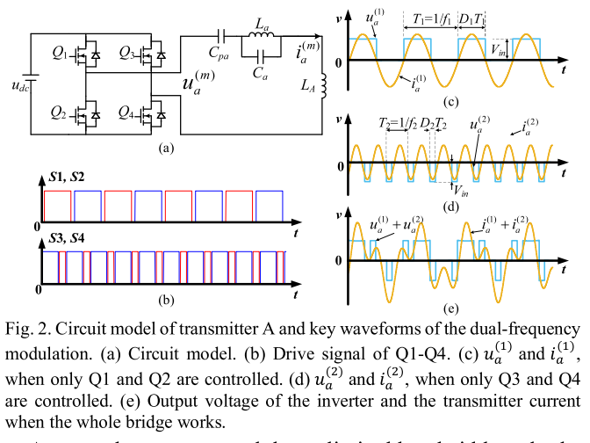
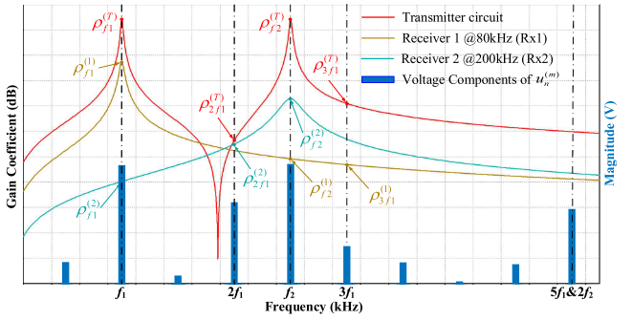
Narrowband Concurrent Wireless Power Transfer (For use of single standard range)
A Dual-Frequency Three-Dimensional WPT System with Directional Power Transfer
Capability at Two Separately Regulated Outputs
Notes:
The WPT system is connected between phase-A and phase B.
By carrier phase shift to phase B, we achieve this contour of the magnitude of the switching frequency.
We can observe that we can have a constant gain for any modulation.
The constant gain is between 0.25 and 0.45 over a DC-link voltage.
The control diagram is shown.
We adjust the carrier phase shift according to modulation to control the WPT power.

Slide 10
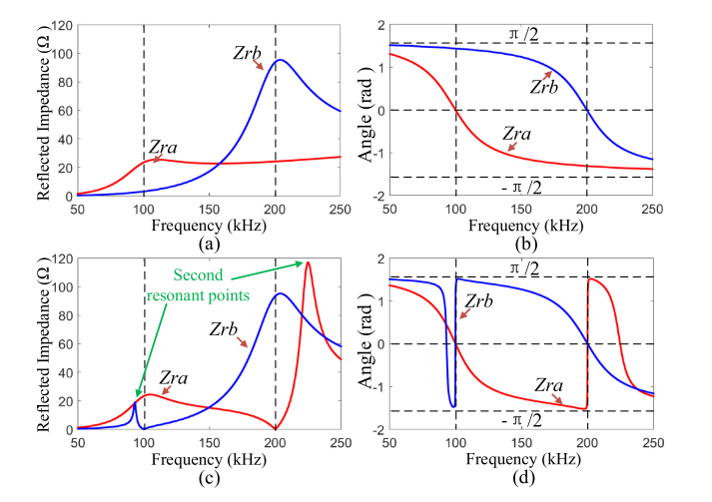
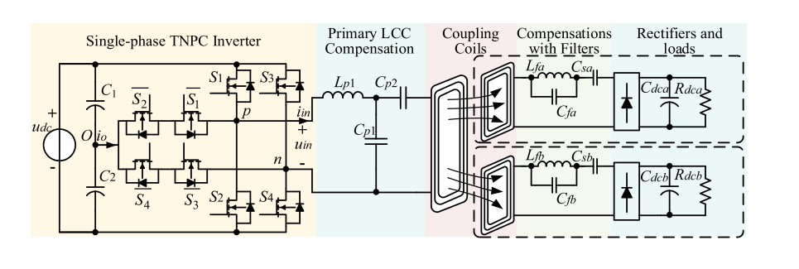
Narrowband Concurrent Wireless Power Transfer (For use of single standard range)
Design and Control of a Decoupled Multichannel Wireless Power Transfer System Based on Multilevel Inverters

Slide 11
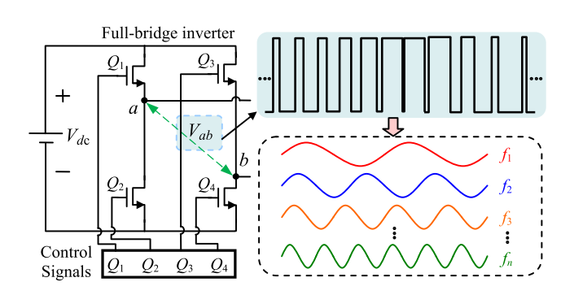
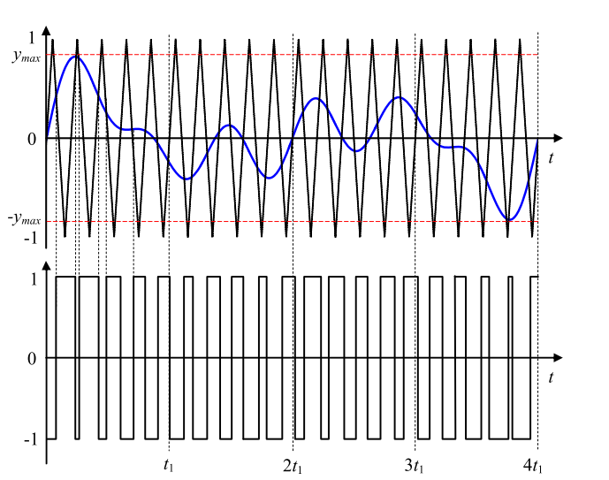
Narrowband Concurrent Wireless Power Transfer
Multi-Frequency Multi-Amplitude Superposition Modulation Method With Phase Shift Optimization for Single Inverter of Wireless Power Transfer System

Slide 12
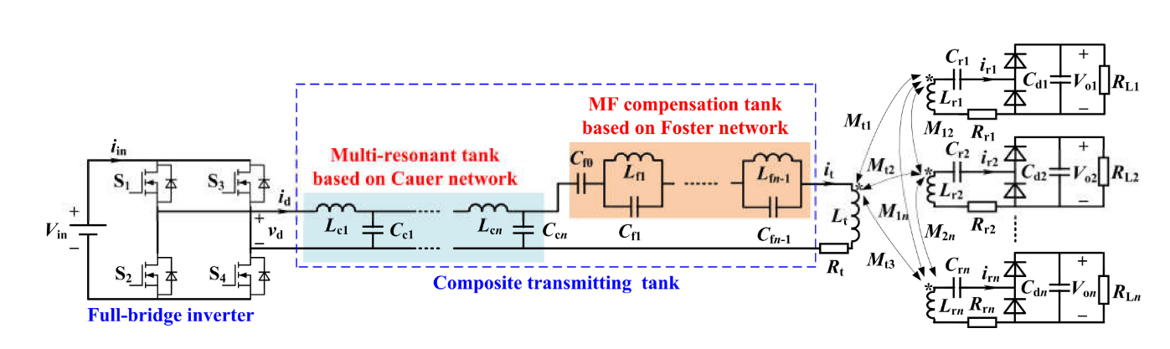
Wideband Concurrent Wireless Power Transfer
Multi-Frequency Multi-Amplitude Superposition Modulation Method With Phase Shift Optimization for Single Inverter of Wireless Power Transfer System

Slide 13
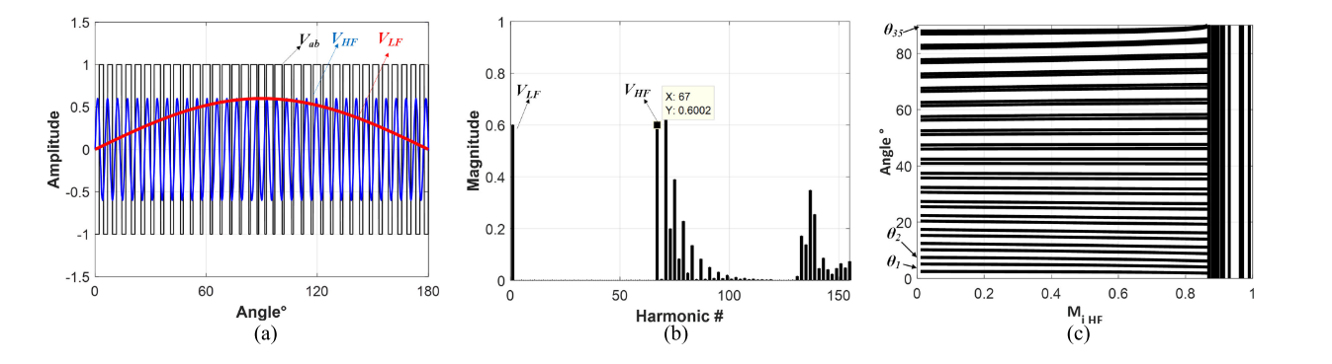
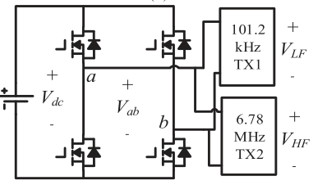
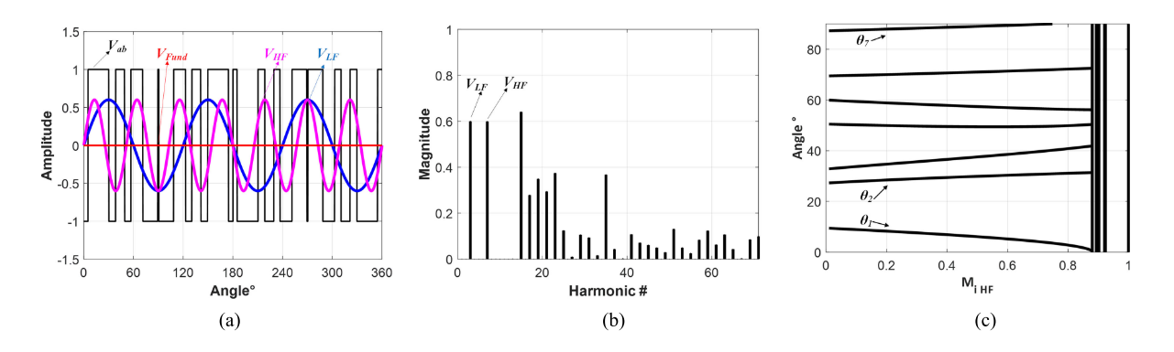
Narrowband / Wideband Concurrent Wireless Power Transfer
GaN-Based Dual-Mode Wireless Power Transfer Using Multifrequency Programmed Pulse Width Modulation

Slide 14
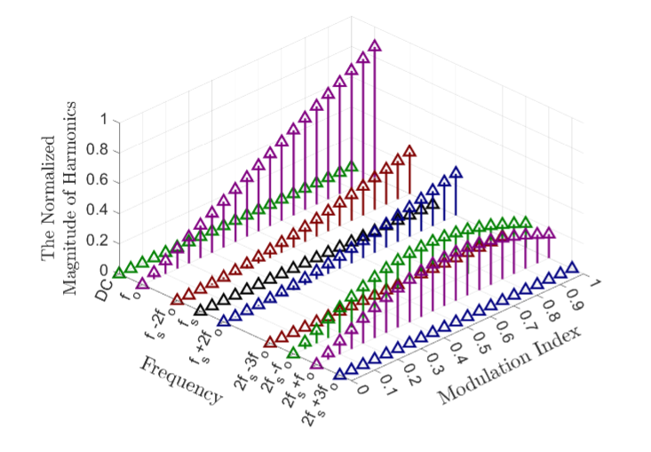
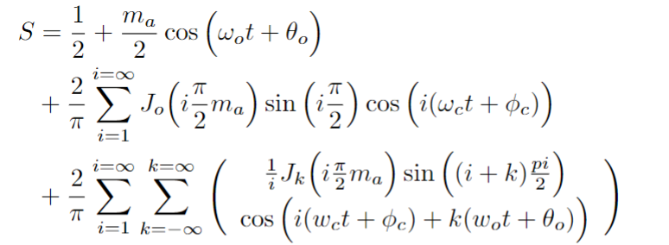
Narrowband and Wideband Concurrent Wireless Power Transfer using a Single Transmitter
SPWM
Notes:
The WPT system is connected between phase-A and phase B.
By carrier phase shift to phase B, we achieve this contour of the magnitude of the switching frequency.
We can observe that we can have a constant gain for any modulation.
The constant gain is between 0.25 and 0.45 over a DC-link voltage.
The control diagram is shown.
We adjust the carrier phase shift according to modulation to control the WPT power.

Slide 15



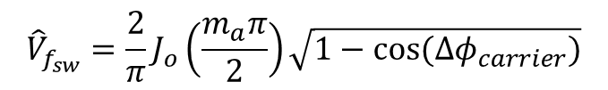






Wideband Concurrent Wireless Power
$$f_{sh}=6980 kHz$$
Control parameters :
Modulation index
Carrier phase shift
$$f_{sl}=6580 kHz$$
$$f_{sw}=6780 kHz$$
$$f_{o}=100 kHz$$
$$f_{0}$$
$$f_{sl}$$
$$f_{sw}$$
$$f_{sh}$$
$${\hat{V}}_{f_{0}}=m_{a}$$
$${\hat{V}}_{f_{sw}}=\frac{2}{π}J_{o}\left(\frac{m_{a}π}{2}\right)\sqrt{1−cos⁡({Δφ}_{carrier})}$$

Slide 16



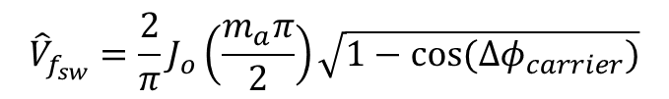





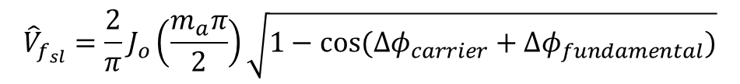




Narrowband Concurrent Wireless Power
$$f_{o}=120 kHz$$
$$f_{o}=80 kHz$$
$$f_{o}=160 kHz$$
Control parameters :
Modulation index
Carrier phase shift
Fundamental phase shift
$$f_{o}=20 kHz$$
$$f_{0}$$
$$f_{sl}$$
$$f_{sw}$$
$$f_{sh}$$
$${\hat{V}}_{f_{sw}}=\frac{2}{π}J_{o}\left(\frac{m_{a}π}{2}\right)\sqrt{1−cos⁡({Δφ}_{carrier})}$$
$$f_{0}=20 kHz$$
$$f_{sh}=160 kHz$$
$${\hat{V}}_{f_{sl}}=\frac{2}{π}J_{o}\left(\frac{m_{a}π}{2}\right)\sqrt{1−cos⁡({Δφ}_{carrier}+Δφ_{fundamental})}$$
$$f_{sl}=80 kHz$$
$$f_{sw}=120 kHz$$

Slide 17
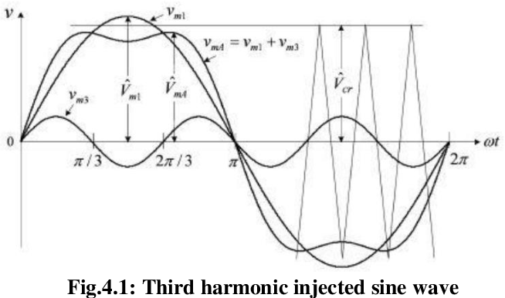















Additional Narrowband/Wideband Concurrent Wireless Power for HB configuration
$$f_{0}$$
$${3f}_{0}$$
$$f_{sl}$$
$$f_{sw}$$
$$f_{sh}$$
$$20$$
$$kHz$$
$$60$$
$$kHz$$
$$80$$
$$kHz$$
$$120$$
$$kHz$$
$$160$$
$$kHz$$
Narrow Band
HB:
It is not possible to introduce carrier or fundamental phase shifts
$$100$$
$$kHz$$
$$300$$
$$kHz$$
$$6680$$
$$kHz$$
$$6780$$
$$kHz$$
$$6880$$
$$kHz$$
Wide Band
Control parameters :
Fundamental modulation index
Harmonic modulation index (3rd , 5th , 7th )

Slide 18
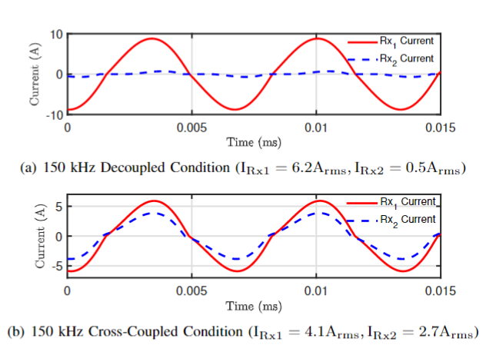
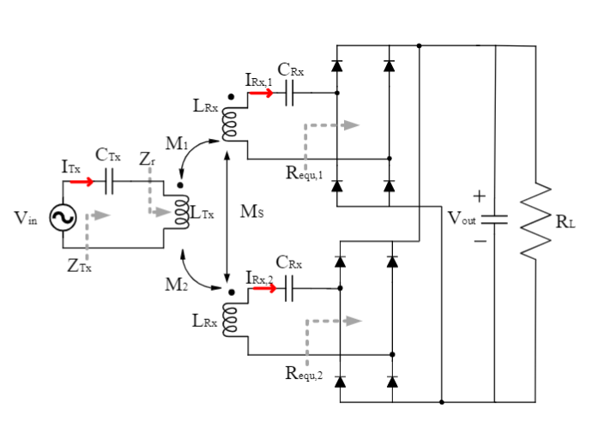
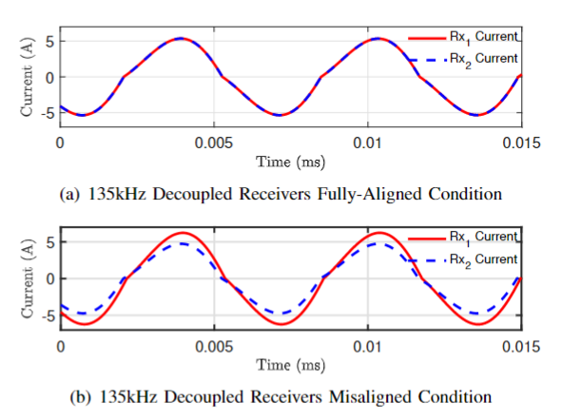
Balancing with Soft-Magnetic Material based Inductors
Intentional de-tuning of the receiver resonant tank for unbalanced modules
Notes:
The WPT system is connected between phase-A and phase B.
By carrier phase shift to phase B, we achieve this contour of the magnitude of the switching frequency.
We can observe that we can have a constant gain for any modulation.
The constant gain is between 0.25 and 0.45 over a DC-link voltage.
The control diagram is shown.
We adjust the carrier phase shift according to modulation to control the WPT power.

Slide 19
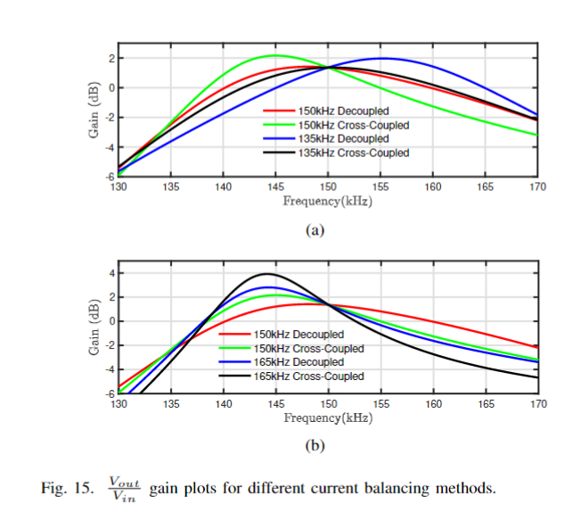
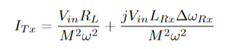
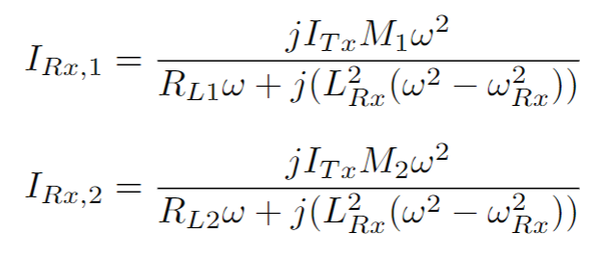
Balancing with Soft-Magnetic Material based Inductors
Notes:
The WPT system is connected between phase-A and phase B.
By carrier phase shift to phase B, we achieve this contour of the magnitude of the switching frequency.
We can observe that we can have a constant gain for any modulation.
The constant gain is between 0.25 and 0.45 over a DC-link voltage.
The control diagram is shown.
We adjust the carrier phase shift according to modulation to control the WPT power.

Slide 20
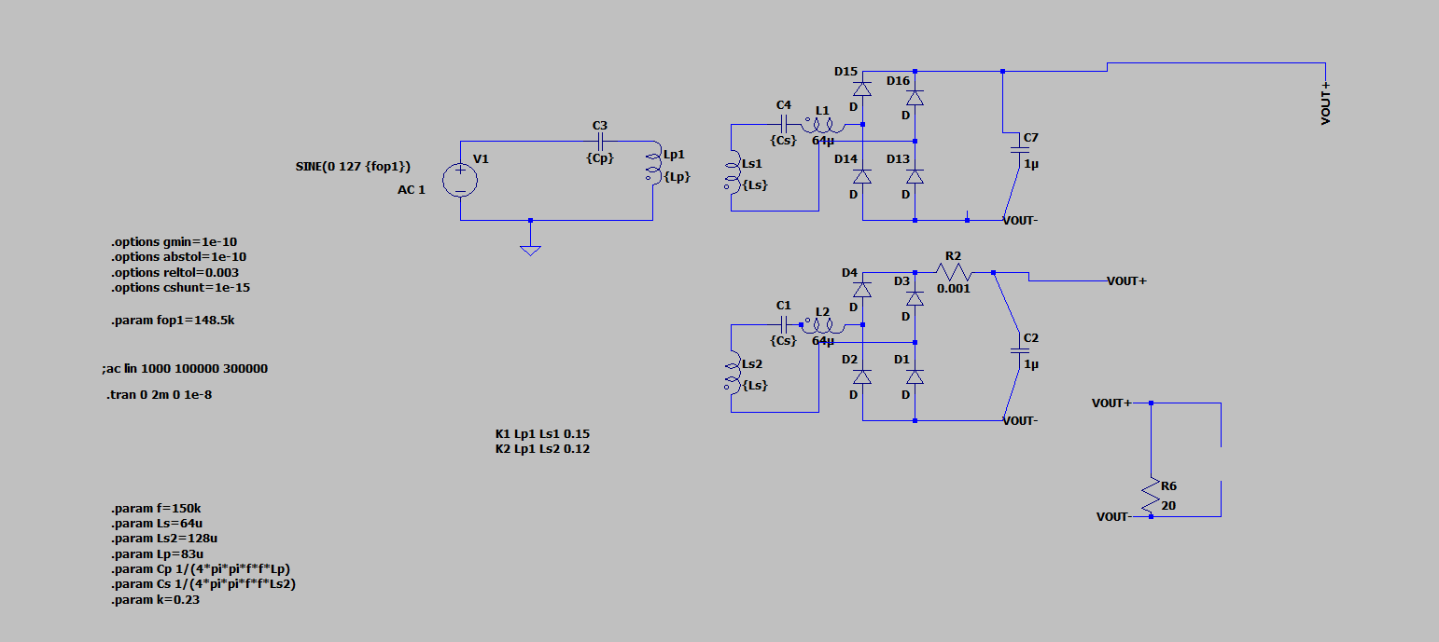
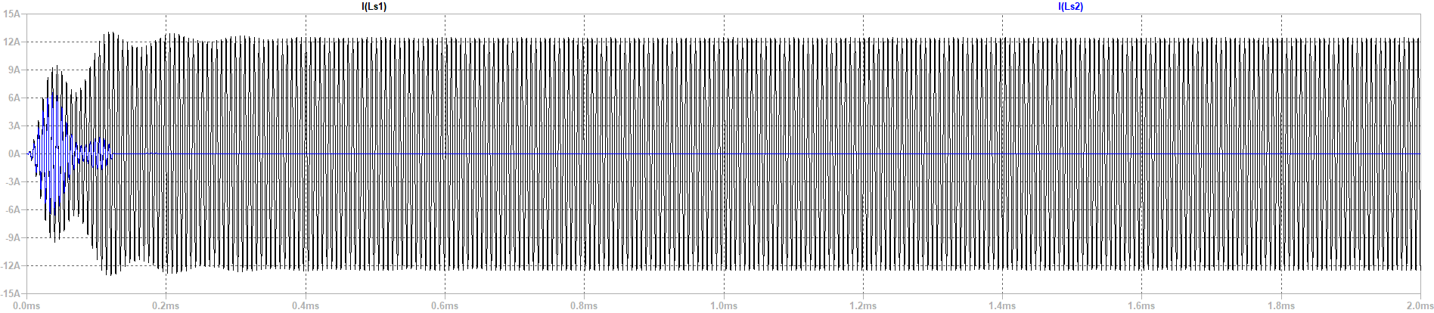

Slide 21
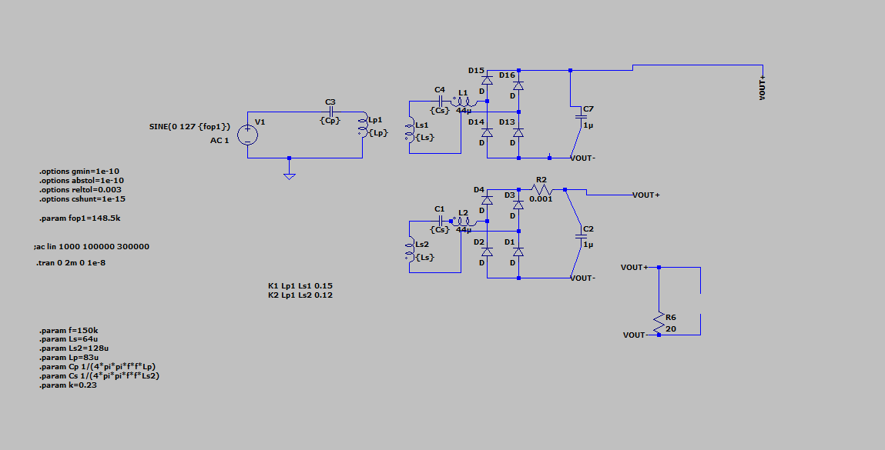
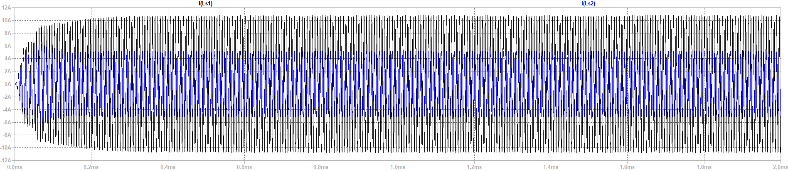

Slide 22
Soft-Magnetic Material based Inductors
Requirement
Saturable Core
Excitation Circuit
Trap Filter
Cost, Size comparison
Notes:
The WPT system is connected between phase-A and phase B.
By carrier phase shift to phase B, we achieve this contour of the magnitude of the switching frequency.
We can observe that we can have a constant gain for any modulation.
The constant gain is between 0.25 and 0.45 over a DC-link voltage.
The control diagram is shown.
We adjust the carrier phase shift according to modulation to control the WPT power.

Slide 23
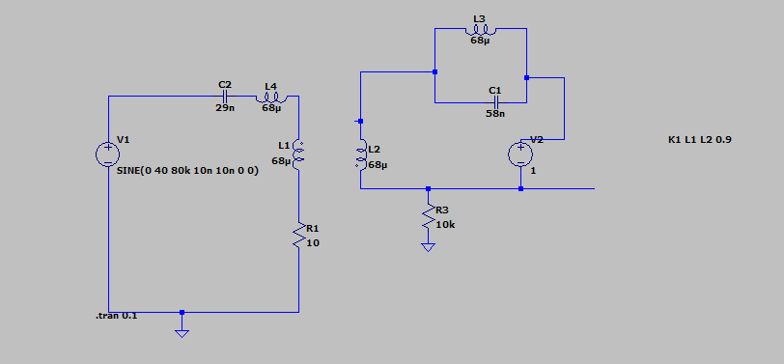
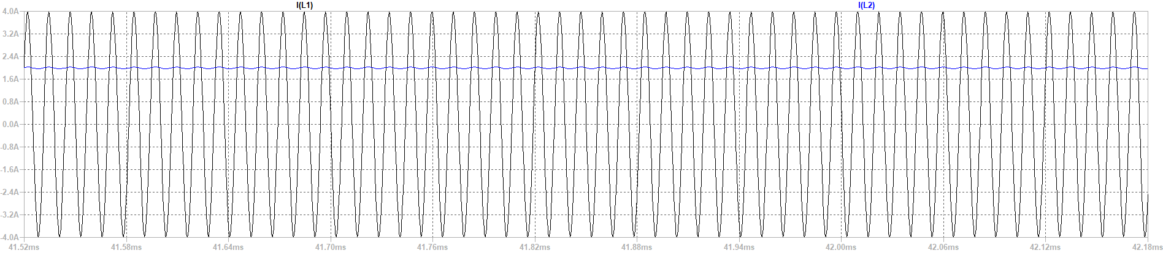

Slide 24

Soft-Magnetic Material based Inductors without additional converter

Slide 25


Slide 26
Future Works
1- Synchronous motor journal : Written, but some experimental results are needed.
2- Preparing Wide/narrow bandgap wireless power transfer journal draft :
Literature Review (almost made)
Analytic modelling :
SPWM is ready
SPWM with additional harmonic is standing
Experimental setup:
Find Of-the-shelf inductance for the story
Power is about 30W to 5W
6.78 MHz with 80kHz-200kHz or 900kHz-1000kHz with 80kHz-200KHz
3-Preparing Balancing journal draft ( we can focusTPEL special section about high power and misalingment)
Discussions to get into focus
High power, series/parallel connection
Cost and feasibility
Notes:
The WPT system is connected between phase-A and phase B.
By carrier phase shift to phase B, we achieve this contour of the magnitude of the switching frequency.
We can observe that we can have a constant gain for any modulation.
The constant gain is between 0.25 and 0.45 over a DC-link voltage.
The control diagram is shown.
We adjust the carrier phase shift according to modulation to control the WPT power.

Slide 27
Thanks!

